Slide 1
Chongqing University of Technology
ATAI
Advanced Technique of Artificial Intelligence
Chongqing Unive
A Discourse-Aware Graph Neural Network for Emotion Recognition in Multi-Party Conversation
(EMNLP-2021)
Reported by Xu Yang，Zhaoze Gao

Slide 2
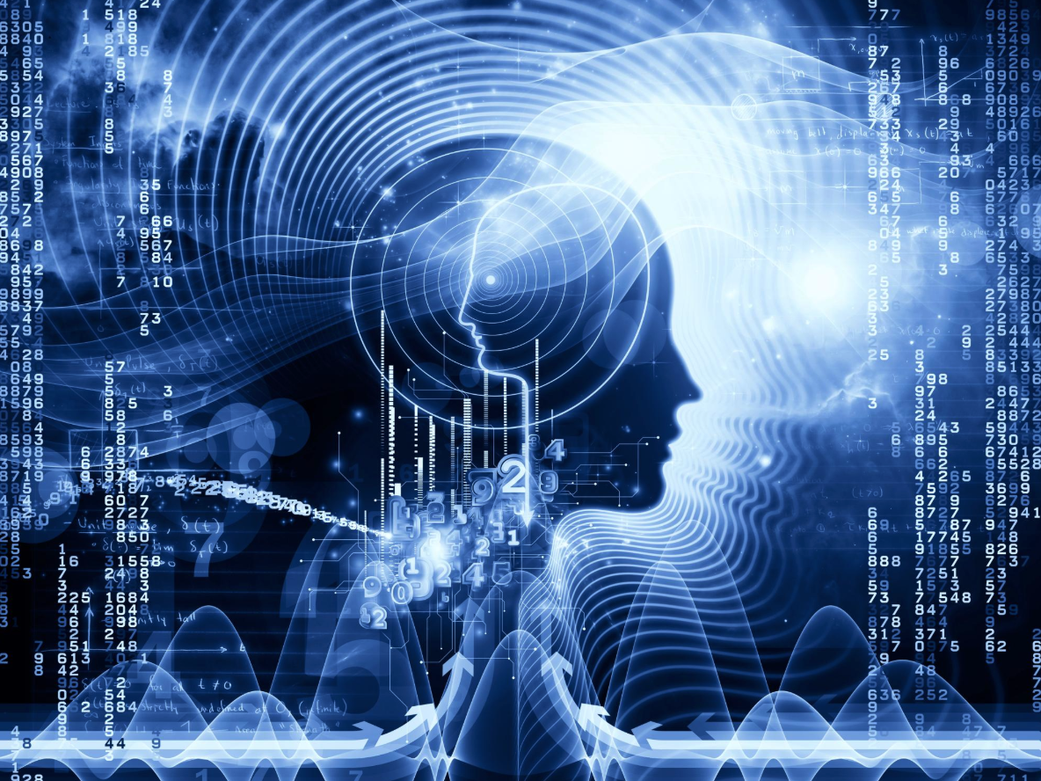
Chongqing University of Technology
ATAI
Advanced Technique of Artificial Intelligence
Chongqing University of Technology
1. Introduction
2. Method
3. Experiments
4. Conclusion

Slide 3
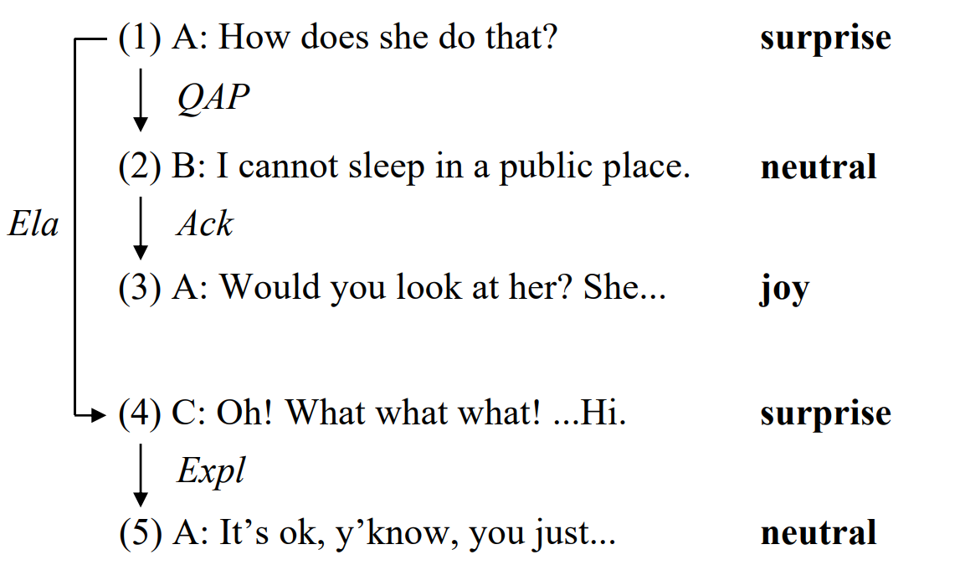
Introduction
Figure 1: An example of the ERC task, the gold labels are different emotions of the utterances, and the discourse structure is shown on the left. QAP, Ack, Ela, and Expl respectively represent the Question-Answer Pair, Acknowledgment, Elaboration, and Explanation relations.

Slide 4
Introduction
• We propose a discourse-aware graph neural network for emotion recognition in multi-party conversation (ERMC).
• We devise a discourse-based relational graph convolution to exploit the self-speaker dependency of interlocutors to propagate contextual information, and further use a gated convolution to select more informative cues for ERMC from dependent utterances.
• The experimental results show our method outperforms multiple baselines, illustrating that discourse structures are of great value to ERMC.

Slide 5
Approach

Slide 6
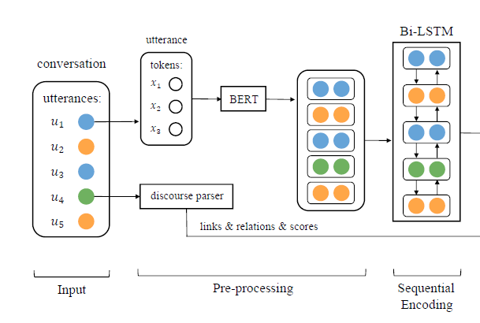
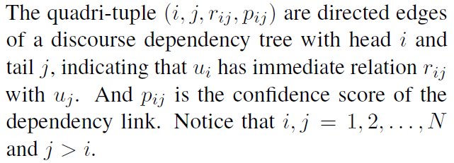
Approach
Input, Pre-processing and Sequential Encoding
Discourse Parsing
Sequential Context Encoding

Slide 7
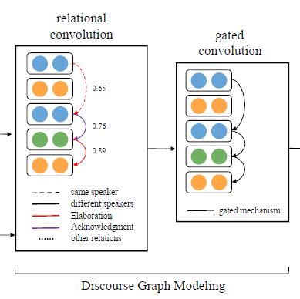
Approach
Edge Weights：
Discourse Graph Modeling
Feature Transformation：

Slide 8
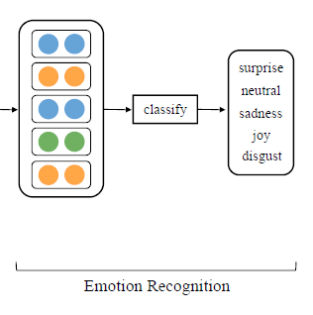
Approach
Emotion Recognition
Cross-entropy loss function：

Slide 9
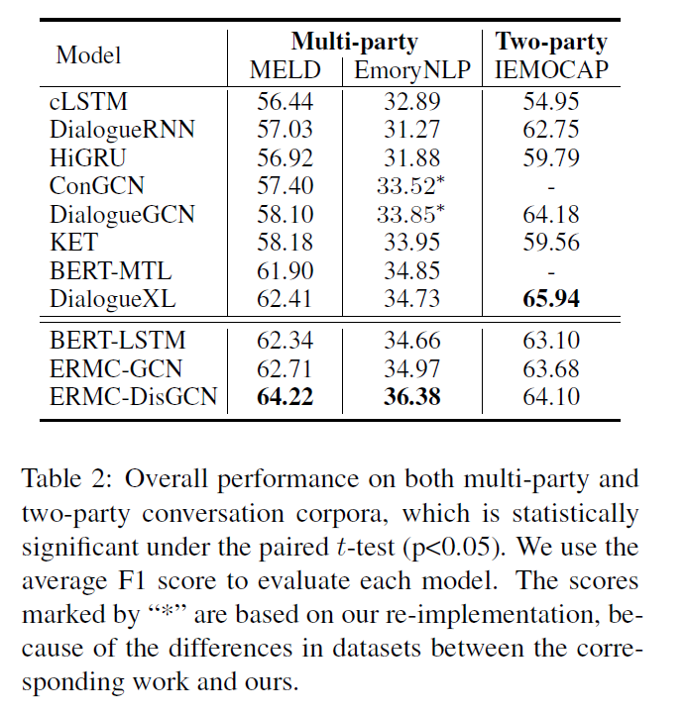
Experiments

Slide 10
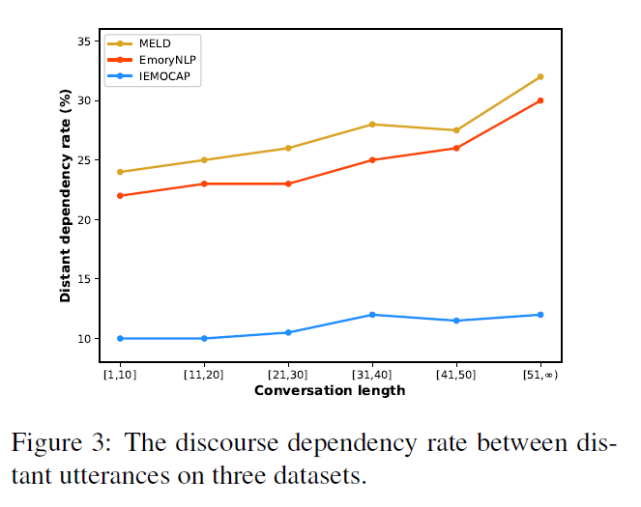
Experiments

Slide 11
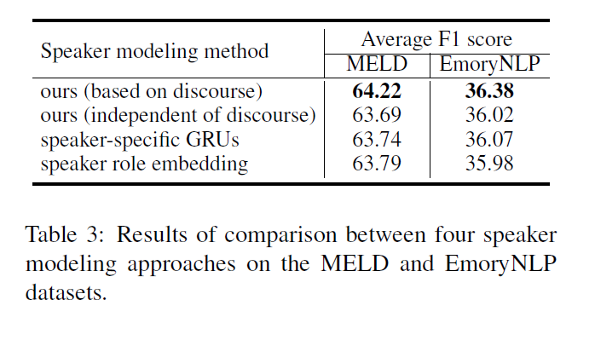
Experiments

Slide 12
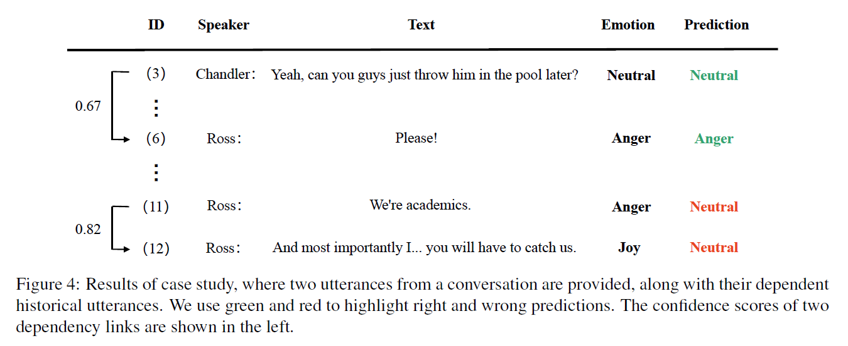
Experiments

Slide 13
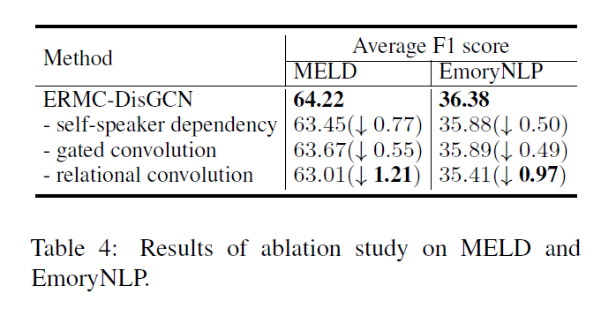
Experiments

Slide 14
Conclusion
We investigated the importance of discourse structures in handling informative contextual cues and speaker-specific features for ERMC.
We proposed a discourse-aware graph neural network and devise two graph convolutional layers to aggregate normalized contextual and speaker-specific information for each utterance in the graph.
Experimental results showed that our proposed model outperforms all the baselines on all multi-party conversation datasets.

Slide 15
Thanks

